Slide 1
PLEASE USE QR CODE TO SIGN-IN

Slide 2
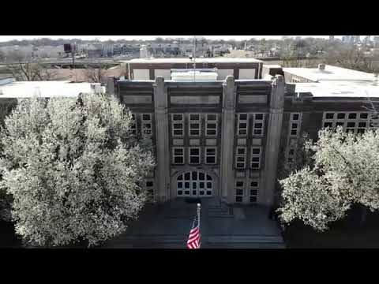
Annual Title 1 Parent Meeting
Wednesday, September 26, 2024 10:00 a.m. & 5:00 p.m.
BELLEVUE MIDDLE SCHOOL

Slide 3
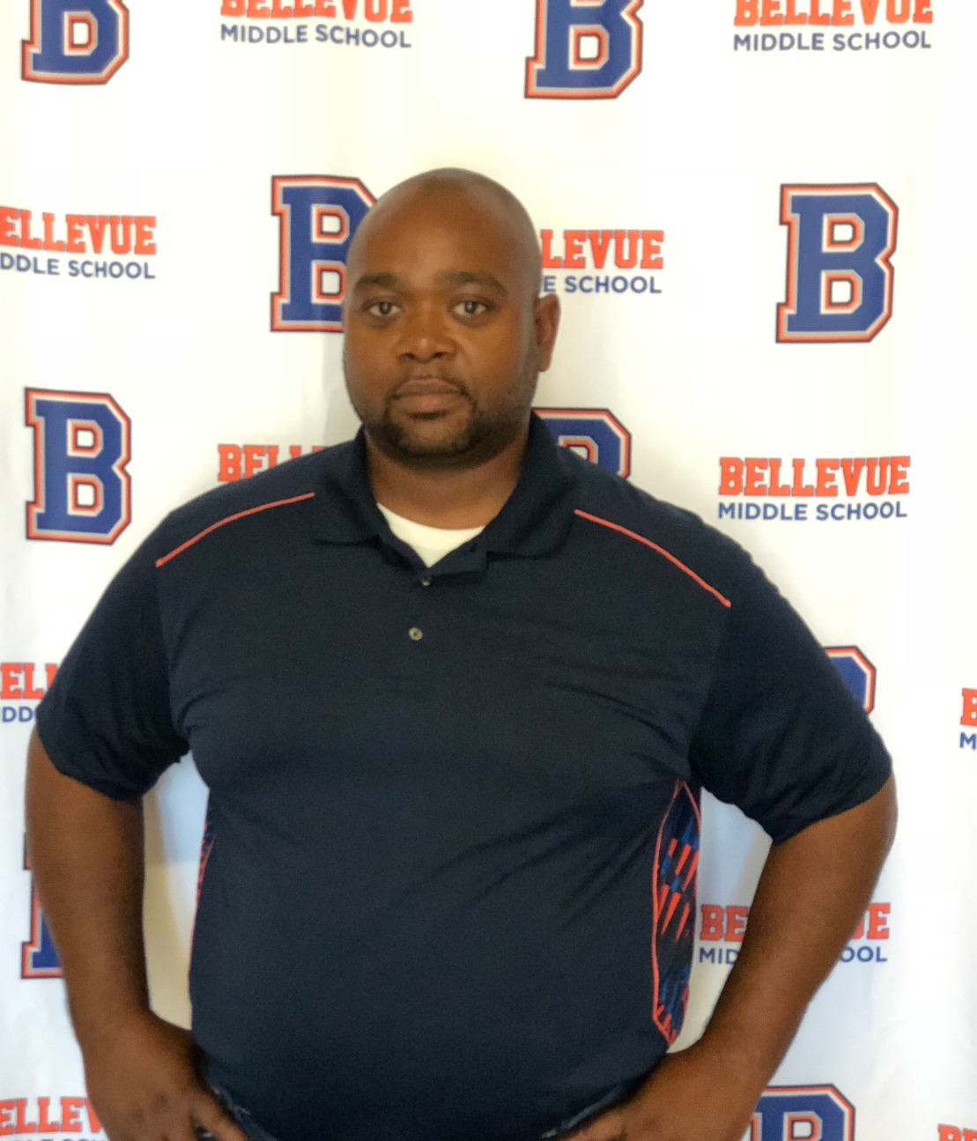
WELCOME TO“THE VUE”
MR. GREEN

Slide 4
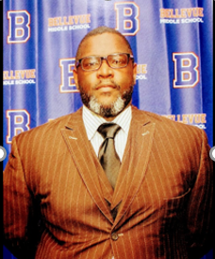
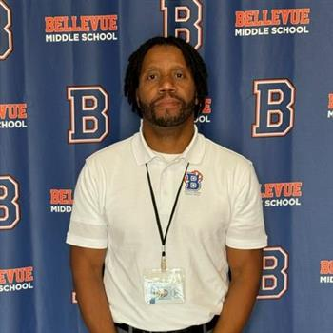
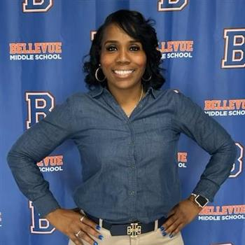
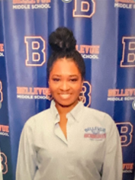
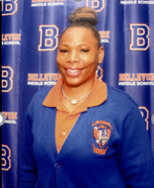
Bellevue Optional Middle School Administrative Team
School Hours 8:05-3:15
School Hours 8:05-3:15
Dr. Frederick White
Principal
Equan Ashe
Dean
Saadia Wright
Optional Coordinator
Dena McNeal
Assistant Principal
Rashida King
PLC Coach
If you have questions, please contact our main office at 901-416-4488

Slide 5
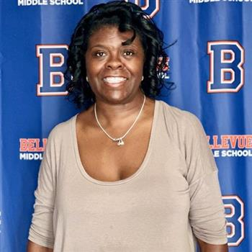
Professional School Counselors
6th & 8th Grade
Vicki Cooper
7th & 8th Grade
Terrica Conley

Slide 6
STAFF INTRODUTION
Dena McNeal
ASSISTANT PRINCIPAL

Slide 7
PTSO
PTSO UPDATES
JULIE ROBERTS
PTSO President
If you have questions, contact Jules Roberts at jules38016@aol.com
NEXT EVENT: “Monster Mash” – Oct. 18th @6:30 – 8:30 p.m.

Slide 8
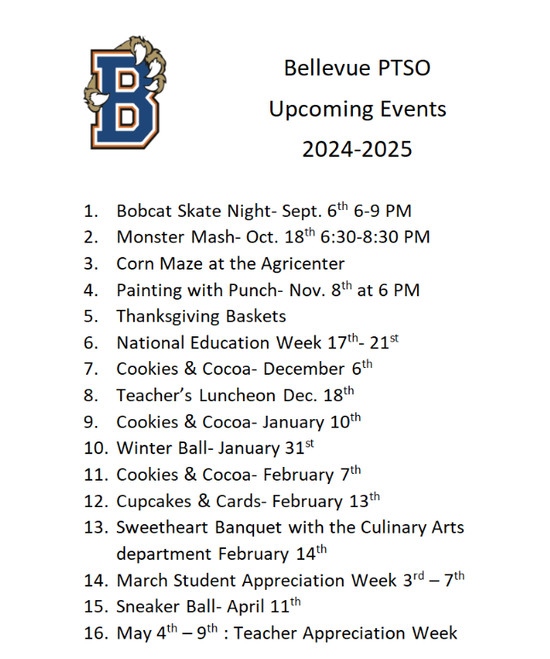

Slide 9
Musical Selection
BAND, MAJORETTE, & DRUMLINE
Directors: Coach MJ & Coach Hill

Slide 10
Title I Parent Meeting Rashida King, PLC Coach

Slide 11
Title I Law
PURPOSE:
“…To ensure that all children have a fair, equal, and significant opportunity to obtain a high-quality education…”

Slide 12
Title I
Why are we here?
The Every Student Succeeds Act (ESSA) requires that each Title I school hold an annual meeting of Title I families in order to:
Inform you of our participation in Title I,
Explain the requirements of Title I, and
Explain your rights as parents and family members to be involved

Slide 13
Title I
What will I learn?
What is a Title I school?
What are my rights?
What can Title I funds be used for?
How does Bellevue Middle use Title I funds?
What is the SIP?
What are our schoolwide program goals?
How is parent and family engagement funded?
What is the Parent and Family Engagement policy?
What is the School-Parent Compact?
What tests will my child be taking?
How can I be involved?

Slide 14
Title I
What is a Title I school?
Title I was passed in 1965 under the Elementary and Secondary Education Act (ESEA). It is the largest federal assistance program for our nation’s schools.
Title I schools receive extra funding from the federal government. These dollars are used to:
Identify students experiencing academic difficulties and provide assistance to help these students;
Purchase additional staff, programs, materials, and/or supplies; and
Conduct parent and family engagement meetings, trainings, events, and/or activities

Slide 15
Title I and the ESEA/NCLB law gives the parents the right to know:
The school’s status according to the NCLB standards
A teacher’s professional qualifications, licensure, or certification
A paraprofessional’s qualifications
Academic services available for your child

Slide 16
Title I
What are my rights?
The families and parents of Title I students have a right, by law, to:
be involved in decisions made at both the school and district level;
be provided with information on your child’s level of achievement on tests in reading/language arts, writing, mathematics, and science;
request and receive information on the qualifications of your child’s teacher and paraprofessionals who are working with your child [insert information about how families can request this information]; and
request opportunities for regular meetings to formulate suggestions and to participate, as appropriate, in decisions about the education of your child. The school is required to respond to any such suggestions as soon as practicably possible.

Slide 17
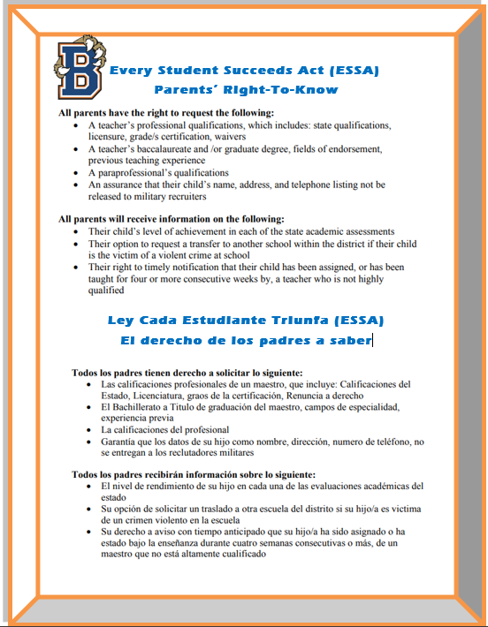
FEP & SCHOOL COMPACT
Make sure you have a copy from sign-in table

Slide 18
Title I
What can Title I funds be used for?
In general, Title I funds may be used for:
smaller class sizes,
additional teachers and paraprofessionals,
additional training for school staff,
extra time for instruction (before and/or after school programs),
parent and family engagement activities, and/or
a variety of supplemental teaching materials, equipment, and technology.

Slide 19
Title I
How does our school use Title I funds?
Our school was allotted approximately $213,532.66 in Title I funding.
We developed a Schoolwide Program, which means we plan to spend our funds on the following:
Supplemental staff
Programs/Materials/Supplies:
Teacher Professional Development
Family Engagement Events
Supplemental Software Programs

Slide 20
Title I
What is the SIP
The SIP is the School Improvement Plan. It includes:
The identification of the school planning team and how they will be engaged in the planning process;
A needs assessment and summary of academic and non-academic data;
prioritized goals, strategies, and action steps to help address the academic and non-academic needs of students;
Teacher and staff professional development needs
Budgets and the coordination of resources.
The school must include family representatives on our school planning team.

Slide 21
Title I
How is parent and family engagement
funded?
Any district with a Title I allocation exceeding $500,000 is required by law to set aside 1% of its Title I allocation for parent and family engagement.
Of that 1%, 10% may be reserved at the district for system-wide initiatives related to parent and family engagement. The remaining 90% must be allocated to all Title I schools in the district.
You, as Title I parents and family members, have the right to be involved in how this money is spent.

Slide 22
Title I
How is parent and family engagement
funded?
In FY2024, we received $2,361. 67 Title I funds for parent and family engagement funding. We plan to use these funds for:
Parent and Family Engagement Meeting and Events
Materials/Supplies

Slide 23
Title I
What is a Parent and Family Engagement Policy?
These plans address how the district and school will implement the parent and family engagement requirements of ESSA. Components should include:
how parents and families can be involved in decision-making and activities;
how parent and family engagement funds are being used;
how information and training will be provided to families; and
how the school will build capacity in families and staff for strong parent and family engagement.
You, as a Title I parent or family member, have the right to be involved in the development of these plans.

Slide 24
Title I
What is a School-Parent Compact?
A school-parent compact is a written commitment that outlines how the entire school community – teachers, families, and students will share the responsibility for improved academic achievement.
The compact must describe how the school will:
provide high-quality curriculum and instruction;
hold parent-teacher conferences, annually in elementary schools;
provide parents with reports on their child’s progress;
provide parents reasonable access to staff.
provide parents opportunities to volunteer; and
ensure regular two-way meaningful communication between family members and staff, to the extent practicable, in a language family members can understand.
You, as a Title I parent or family member, have the right to be involved in the development of the compact (this has already occurred!)

Slide 25
FEP & SCHOOL COMPACT
RASHIDA KING, PLC COACH
Email any revisions to kingrk@scsk12.org

Slide 26
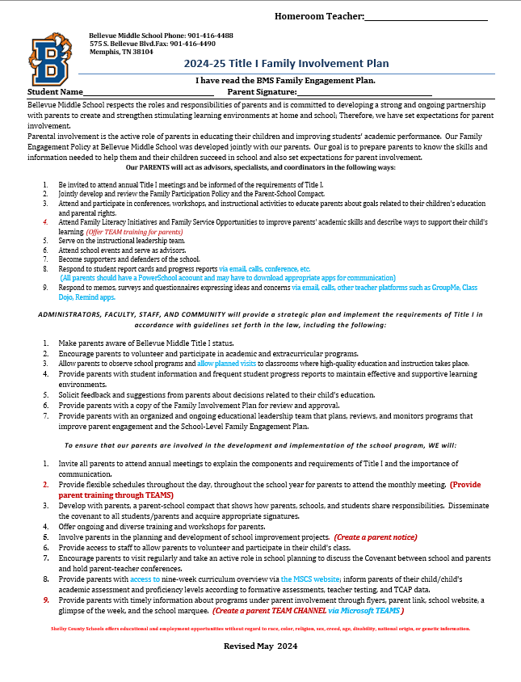
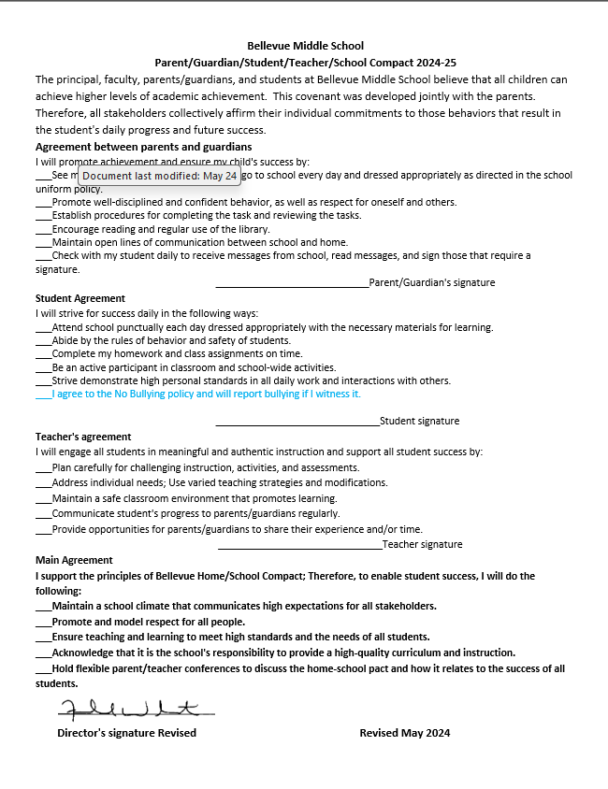
Family Engagement Plan/School Compact 2024-25
Sign off with HR Teacher

Slide 27
Title I
What tests will my child be taking?
IReady Fall, Winter, and Spring Diagnostics
Teacher Created Common Formative Assessment
1st, 2nd, 3rd, 4th Quarter
State mandated TCAP, Algebra I EOC

Slide 28
Title I
How can I be involved?
Encouraging attendance
Monitoring grades and schoolwork on PowerSchool
Attending family events like this one
Reading emails and flyers to stay up to date with testing dates and what’s going on in our school.
Following us on social media

Slide 29
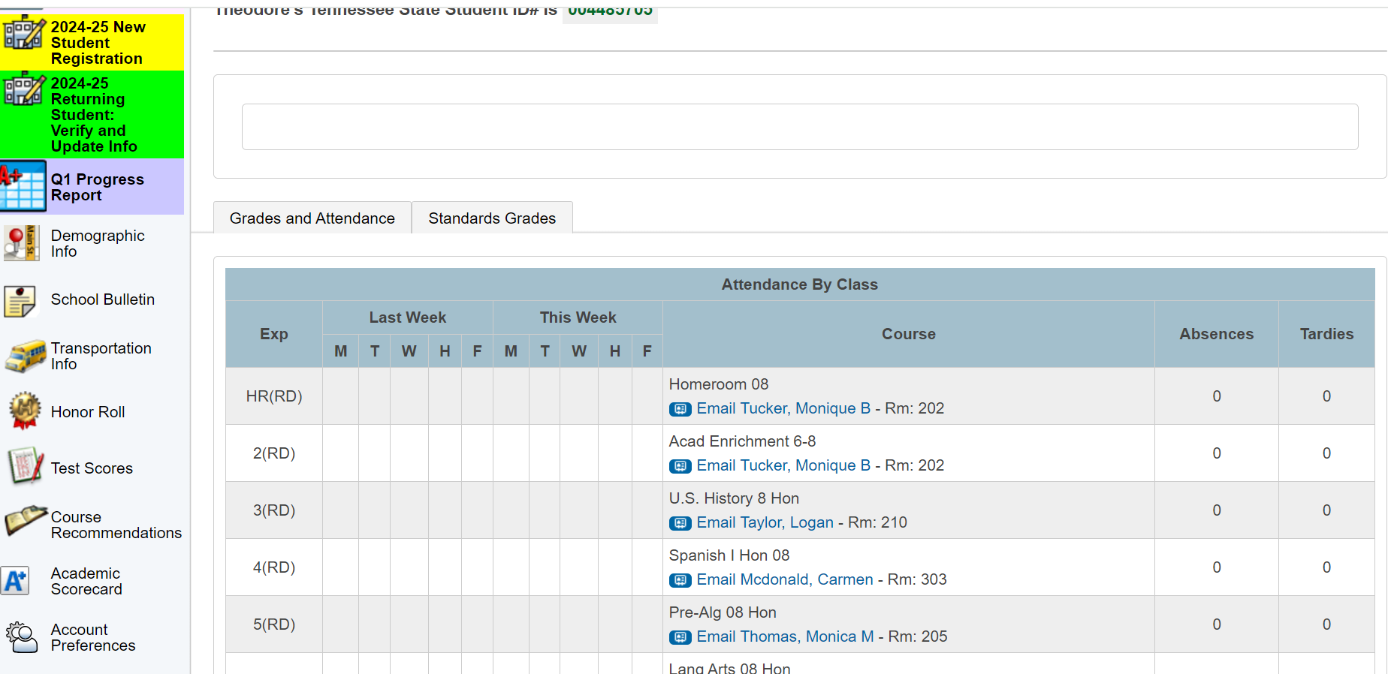
STUDENT ACADEMIC SCORE CARD
This data can be found in PowerSchool

Slide 30
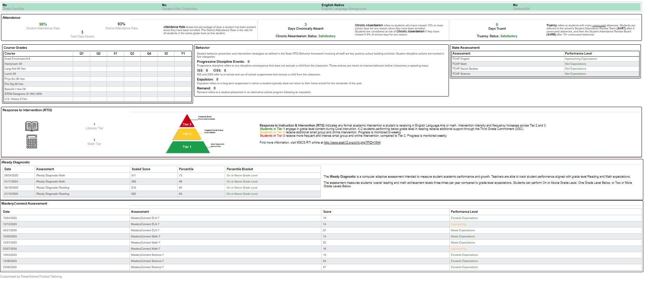
STUDENT ACADEMIC SCORE CARD
If you don’t have access, please see Ms. Watkins in the front office
Scorecard includes Quarter grades, TCAP/EOC Level, IReady Diagnostics

Slide 31
TCAP Family Portal
The TCAP Family Portal is provided by the Tennessee Department of Education.
Parents can access the TCAP Family Portal at familyreport.tnedu.gov.
Parents can access their students’ test scores using the TCAP Family Portal.
One barrier to parents using the TCAP Family Portal is that it requires them to know their child’s TN student ID. This TN Student ID is different than the student’s PowerSchool ID. It is also important to put two zeros in front of the student’s 7-digit ID.

Slide 32
TCAP Family Portal

Slide 33
TCAP Family Portal

Slide 34
TCAP Family Portal

Slide 35
TCAP Family Portal

Slide 36
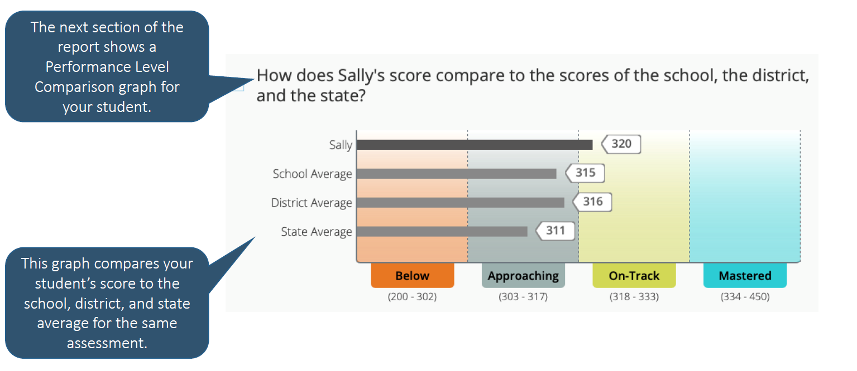
TCAP Family Portal

Slide 37
TEACER QUALIFICATIONS
ONLY 2/37 PROFESSORS ARE WORKING TOWARDS LICENSURE IN THE SUBJECT THEY TEACH

Slide 38
SCHOOL DATA
Dr. Fred White
PRINCIPAL

Slide 39
WE ARE A
SCHOOL GRADE STATUS
GRADE A OR B | “SOAR” SCHOOL
GRADE C | “IGNITE” SCHOOL
GRADE D OR F | “SUP” SCHOOL

Slide 40
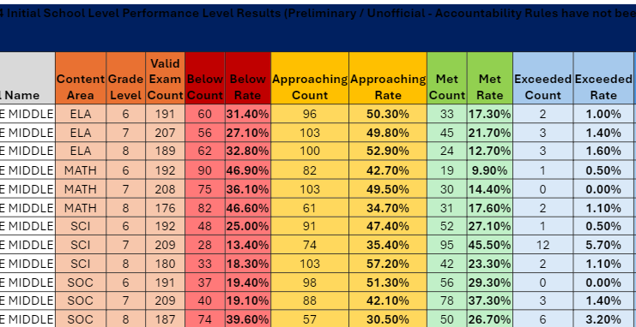
2023-24 Overall Results

Slide 41
2023-24 TVAAS Results ELA

Slide 42
2023-24 TVAAS Results MATH

Slide 43
2024-25 TVAAS Results SCIENCE

Slide 44
2023-24 TVAAS Results SOC. STUD.

Slide 45
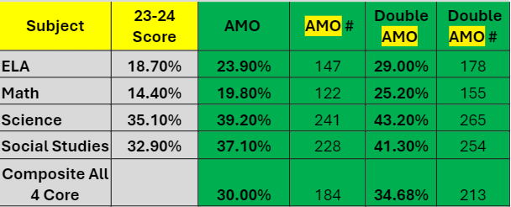
2024-25 AMO Targets

Slide 46
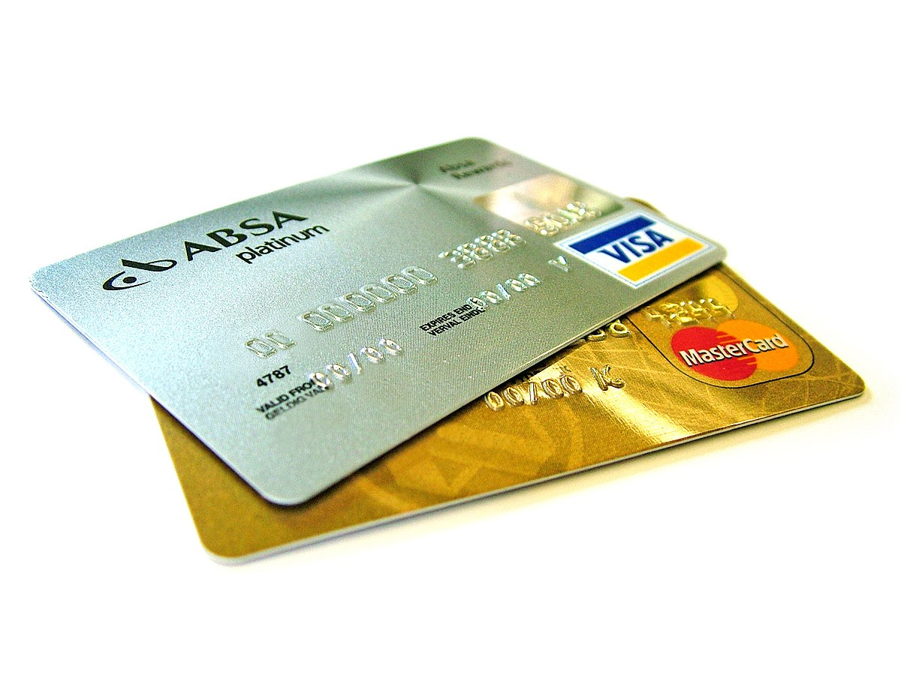
BMS
1ST Quarter Redemption Day
Wednesday, October 30th, 2024
Immediately after school in the Cafeteria

Slide 47
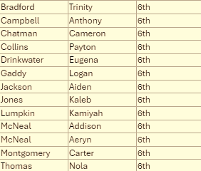
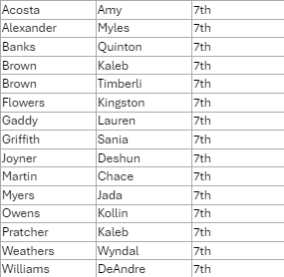
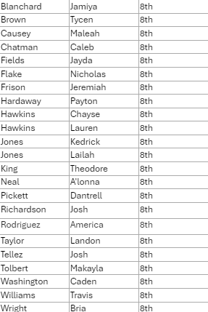
GOAL CARD PARTICPANT 2024-25

Slide 48
BMS Unified Expectations
TERRICA CONLEY –PROFESSIONAL SCHOOL COUNSELOR

Slide 49
R.O.A.R
R
O
A
R
esponsible
wnership
cceptance
espectful

Slide 50
2024-25 Behavior Matrix

Slide 51
Classroom Expectations

Slide 52
Auditorium Expectations

Slide 53
Cafeteria Expectations

Slide 54
Hallway Expectations

Slide 55
Restroom Expectations

Slide 56
Suggestions? Comments? Concerns? Questions?

Slide 57
Approaches to Literacy Grant
MS. POE

Slide 58
FAMILY ENGAGEMENT SPECIALIST
Sylvester Fulton
(901) 416-4488 fulton@scsk12.org

Slide 59
Upcoming Parent Training
FAMILY FINANCIAL PLANNING - TBA
Mr. Fulton @ fulton@scsk12.org

Slide 60
Grade Level Expectations
MCNUTT, JACOBS, TUCKER
Ask your scholar about contracts

Slide 61
Bellevue Middle Culture of Excellence
Student Expectations
AP MCNEAL

Slide 62
We need your support as we work hard to give our scholars a quality experience virtually.
How can you help?
Review this information with your scholars so that we are all on one accord to make this a successful school year.

Slide 63
6th Grade Academy Uniforms
Gray
Royal Blue

Slide 64
What students wear?
Shoes must be closed toe and have a back on them
7th & 8th Grade scholars wear white and orange polo shirts
School Hours 8:05-3:15
Undershirts colors allowed are white, blue, orange, black and gray

Slide 65
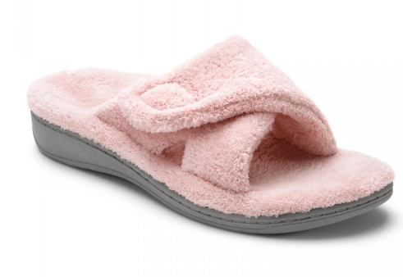
What students don’t wear!
School Hours 8:05-3:15

Slide 66
UNIFORM DISCOUNTS
Don’t forget to stop by the uniform table
This excludes P.E. Uniforms

Slide 67
CELL PHONE POLICY

Slide 68
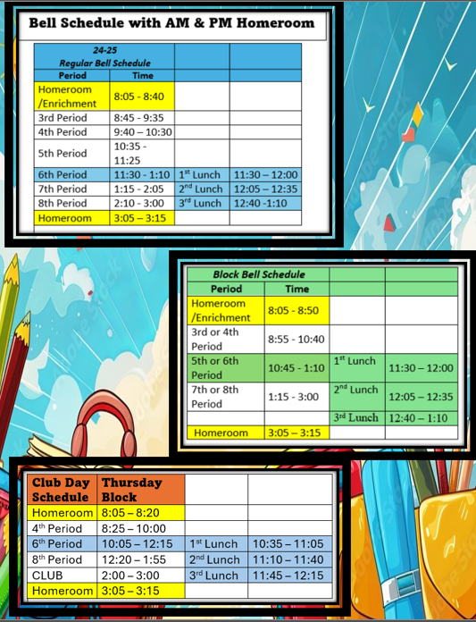
BMS Bell Schedule

Slide 69
“THE RACE TO EXCELLENCE HAS NO FINISH LINE”

Slide 70
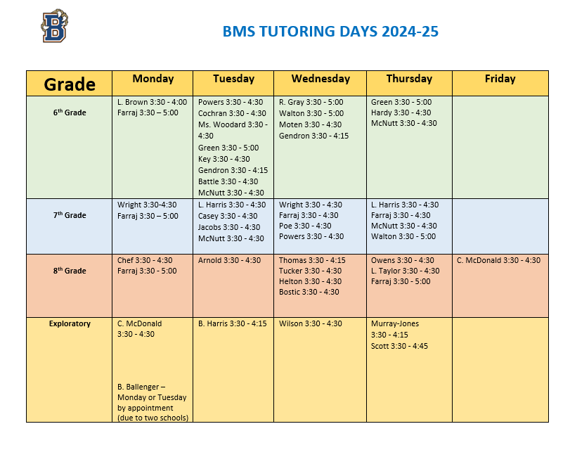
TEACHER TUTORING SCHEDULE
COPIES OF THIS DOCUMENT ARE AT THE FRONT TABLE

Slide 71
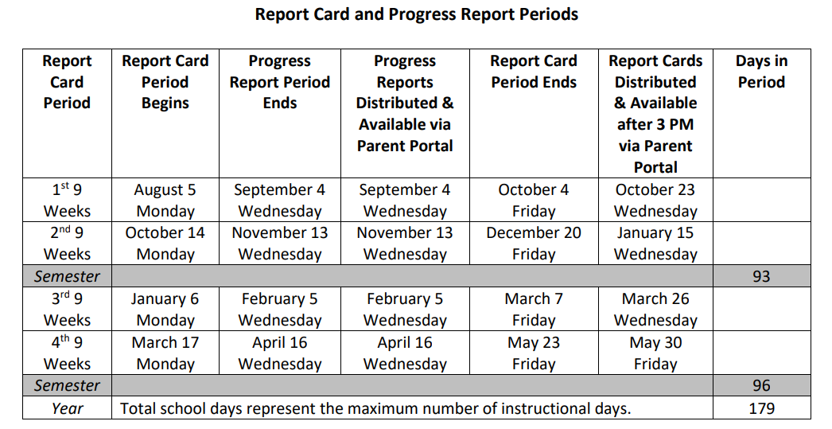
Report Card Period

Slide 72
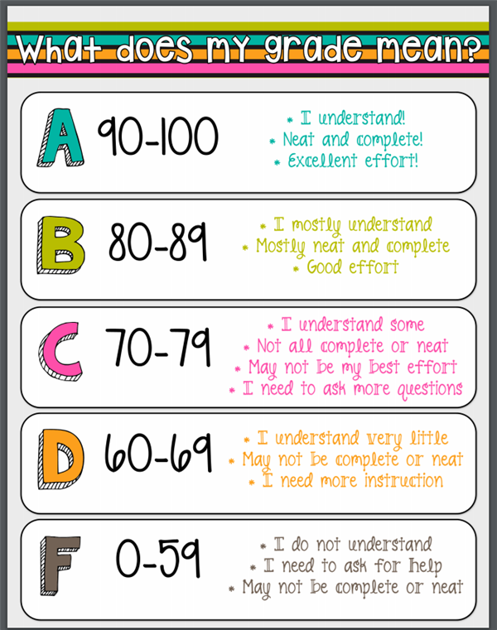
GRADING SCALE
Encourage your scholar to take advantage of after school tutoring

Slide 73
to win:
Notes:
73

Slide 74
Did you know that if your child misses one day of school every two weeks, they miss out on 20 days per year, which is the equivalent of four weeks per year and almost 1.5 years over 13 years of schooling? Now, if your kid even misses an hour of school each day, that's a full day a week, three weeks a year, and 2.5 years throughout 13 years of schooling.
When it comes to attendance,
there is a lot at stake.
Notes:
74

Slide 75
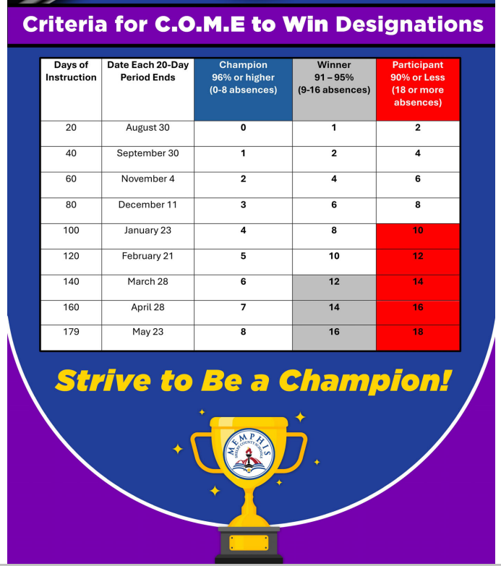
Notes:
75

Slide 76
6th Grade Attendance Champion 1st 20 Days
Brown, Iarbie
Brown, Jannie
Bunton, Kameron
Burress, Kiersten
Butler, Miles
Caldera-Grable,Bryce
Campbell, Anthony
Carter, Kingston
Casey, Zaire
Chatman, Cameron
Dailey, Jordyn
Davis, Ahamad
Davis, Rylon
Deberry, Brian
Domingo-Lopez, Daisy
Emery, Rarecas
Evans, Aubrey
Gaddy, Logan
Gardner, Samule
Goodman, Aubrey
Hall, Gabriella
Harrell, Lacee
Harris, Kelyn
Harris, Marcus
Akemon, Makyia
Bailey, Caylee
Banks II, Antonio
Bell, Elijah
Bennett, Penelope
Bethea, Angel
Betts, Asia
Booker, Shaquille
Boyd, Devin
Boykin, Juanye'
Bradford, Trinity
Brigance, Tristin
Notes:
76

Slide 77
6th Grade Attendance Champion 1st 20 Days
Harrison, Torri
Hart, Gracie
Harvey, Ayden
Hill, McKenzie
Hughes, Olivia
Ivory, Jhamel
Jackson, Jersee
Johnson, Cortez
Johnson, Gavin
Johnson, Kingman
Johnson, Mar'Lei
Johnson, Taylor
Jones, Christen
Jones, Peyton
Lester, Mallory
Lomax, Aryanna
Looney, Salena
Lumpkin, Kamyia
Mays, Kylen
McDowell, Tia
McFann, Cor'Darrin
McNeal, Addisyn
McNeal, Aeryn
McNeil, Nathan
Merritt, Zion
Mhoon, Ariyane
Miles, Tyler
Millbrook IV, Clarence
Miller, London
Morrow, Ava
Morrow, Spencer
Moss, Marshawn
Nelson Jr., Kevin
Noor, Farhan
Northington, Lyric
Norwood, CorMara
Notes:
77

Slide 78
6th Grade Attendance Champion 1st 20 Days
Owens, Ayanna
Patterson, Alaysia
Pirtle, Bryson
Powell, Maryan
Razor, Taniyah
Settles, Aaliyah
Shannon, Demetria
Sims, Khristian
Smith, Jaylon
Smith, Landon
Stephens, Maurice
Stewart, Anthony
Taylor, Tyran
Terrell, Christian
Thomas, Dania
Thomas, Deja
Thomas, Jimeya
Thomas, Jordyn
Thomas, Nola
Tribble, Christian
Tucker, Romel
Vann, Kaiden
Weddington, Darrius
Whitney, Caylee
Whitney, Chloe
Wilbon, Victor
Williams, Dashun
Williams, Geremiah
Williams, Madison
Woodson, Elijah
Wright, Brandon
Wright, Darria
Notes:
78

Slide 79
7th Grade Attendance Champion 1st 20 Days
Aguirre-Tovar, Bernardo
Akemon, Mazyia
Alexander, Myles
Alexander, Roderick
Allen, Dash
Anderson, Aydinn
Bachus, Jacob
Barber, Randi
Bell, NiKyla
Bethea, Juelz
Betts, Destinee
Bohannon, Courtney
Boone, Mi'Ronica
Boyland, Kennedi
Brown, Kaden
Brown, Kaleb
Burns, Mylan
Chambers, Nia
Chilel, Kennedy
Cooper, Daven
Davis, Raegan
Dickerson, Jaylen
Douglas, Jacari
Draper, Jari
Evans, Derrick
Flowers, Kingston
Ford, Marshay
Foster, Jayden
Gaddy, Lauryn
Gales, Ny'Asijah
Garrett, Austin
Goldsmith, Cassidy
Griffith, Sania
Hardaway, Prince
Hernandez, Maria
Hill, Imani
Notes:
79

Slide 80
7th Grade Attendance Champion 1st 20 Days
Hilliard, Marcellus
Hines, Symarius
Hobbs, Naja
Hughes, Robert
Jackson, Jaden
Jamerson, Braxton
Jamerson, Brielle
Johnson, Dayla
Johnson, Dillon
Jones Jr., Andrew
Jones, Cory
Jones, KaSyn
Jones, Madison
Jordan, Hannah
Joyner, Deshun
Kelly, Blake
Laird, Anissa
Logan, Mariah
Mallory, Arieauna
Mansur, Joseph
Martin, Chace
Mayweather, Cody
Miller, Jaiden
Minnis, Marcus
Moore, Ka'Mari
Morales-Alvarado, Erikson
Myers, Jada
Nevills, Anthony
Owens, Kollin
Patterson, Chloe'
Perry, Kamari
Phelps, Jalill
Pinkins, Cameron
Polk, Malik
Prater, Kaileb
Price, Kerrington
Notes:
80

Slide 81
7th Grade Attendance Champion 1st 20 Days
Robinson, Iyana
Rollins, Zae'le
Russell, Faith
Saffold, Zavion
Shackleford, Aubri
Shaw, Joshua
Skinner, Khailynn
Sledge, Autumn
Smith, Ebony
Smith, London
Stevenson, Mariah
Tate, Aniya
Tate, Khloe
Taylor, Kamya
Thomas, Marcheon
Thomas, Nyleecia
Vaughn, Ayanna
Vaughn, Zayden
Ward, Destinee
Ward, Joshua
Weathers, Wyndee
Wilburn, Mackenzie
Williams, Bella
Williams, DeAndre
Williams, Desirae
Williams, Dynasty
Williams, Terrence
Notes:
81

Slide 82
8th Grade Attendance Champion 1st 20 Days
Baskerville, Jan'ya
Bennett, Cayden
Bethea, Gregory
Betts, Brandon
Blue, Kamesha
Blue, Kassie
Bonds, ZeNiya
Breakfield, Lucas
Broadway, Ta'Tianya
Brown, Tycen
Burgess, Trenton
Byrd, Kyris
Campbell, Cayleb
Cansler, Jhayden
Carpenter, Jalil
Catalan, Francis Keith Julian
Causey, Maleah
Chatman, Caleb
Currie, Alexandria
Curry, Tremaine
Custard, Mason
Davis, Asante
Dean, Kameron
Dixon, Kriston
Drain, Christopher
Eskridge, Mekhi
Flake, Nicolas
Frison, Jeremiah
Funzie, Dorrian
Gamble, Mariah
Garcia, Ashly
Gill, Genevieve
Gray, Janyia
Gray, Ka'miyah
Gray, Melaya
Greene, Aniyah
Notes:
82

Slide 83
8th Grade Attendance Champion 1st 20 Days
Griffin, Elijah
Hawkins, Chayse
Hawkins, Lauren
Henderson, Jenae
Herron, Mikiyah
Hicks, Collin
Hicks, McKenzie
Hill, Dontavious
Hines, Kennadi
Jacks, Amberlyn
James, Kamiyah
Jenkins, Isaiah
Jiguan, Diego
Johnson, Kingston
Jones, Aiden
Jones, Kedrick
Jones, Lailah
King, Theodore
Kyles, Morgan
Lee, Gavin
Logan, Christian
Matthews, Caleb
McClain, Elijah
Mcfann, Wil'Jaylin
Mhoon, Armani
Monger, Nicholas
Morgan, Jordan
Morgan, Jorian
Munoz, Esperanza
Neal, A'lonna
Owens, Alyssia
Patrick, Christiana
Pearson, Kamryn
Pham, Hieu
Phillips, Violet
Pickens, Jayce
Notes:
83

Slide 84
8th Grade Attendance Champion 1st 20 Days
Pickett, Dantrel
Porter, Malia
Proctor, Tavarreon
Proffitt, Joseph
Qualls, Jason
Robinson, Anaiyah
Rodriguez Guevara, Hailey
Rodriguez, America
Rodriguez, Annie
Saulsberry, Autumn
Shearer, Latrell
Smith, Jeramiah
Smith, Landon
Smith, Markayla
Stevenson, Lacy
Tatum, Saniyla
Taylor, Addisyn
Taylor, Dalia
Taylor, Landon
Tellez, Joshua
Terrell, Darian
Thomas, Dabria
Traywicks, Makaela
Tuggle, Kentavious
Turner, Aaron
Upchurch, Kerry
Van Rensalier, Alexandria
Washington, Caden
White, Maki
White, Timothy
Williams, Angel
Williams, Jada
Woods, Sham
Wright, Braiden
Wright, Bria
Young, Makiah
Notes:
84

Slide 85
Notes:
85

Slide 86
Notes:
86

Slide 87
Notes:
87

Slide 88
Grade Level Information 6th Grade Mr. McNutt/MsBattle 7th Grade – Ms. Wright 8th Grade – Mrs. Tucker

Slide 89
Reminders & FAQ
All Professors have Emails, & Tutoring Days & Times. Parents, please use one of these options to speak with professors about your scholars' individual concerns. Let’s avoid conferencing during the class time.
Some professors use RemindApp to send out personal class reminders.
TECH Support Hotline is available M-F, 8 a.m. - 5 p.m., at (901) 416-2700.
PowerSchool is the easiest way to keep track of Scholars Grades. Get the app and stay abreast. Please allow 3-5 days for grade changes or updates in PowerSchool. – WATKINSLM@scsk12.org
Thanks for your patience as we make daily decisions to do what best for ALL Scholars at DAVUE!!!

Slide 90
Title 1 evening meeting Thursday, September 26, 2024@5:00
I Ready Fall Diagnostic should be complete (your scholar should know their results)
Progress Reports were issued– 09/04
Report period ends 10/04
Report cards issued 10/23
Fall Break 10/07– 10/11
JV Football October 2nd at Lausanne@5:00
Football game 1st round starts October 5th
Girls soccer Sectional Game Monday, September 30th at Hickory Ridge Middle @5:00
PTSO “MONSTER MASH” 10/18@6:30 P.M. – 8:30 P.M.
Tuesday 11/05 Election Day/ Students Out
Monday 11/10 Veteran’s Day (No school for Students & Teachers)
Thanksgiving Break 11/25 – 11/29
Next Parent Teacher Conference Thursday 02/13 from 4-7pm

Slide 91
Closing Remarks - ADMINISTRATION
“THE RACE TO EXCELLENCE HAS NO FINISH LINE”

Slide 92
Keep up with “The VUE”
Website – https://schools.scsk12.org/bellevue-ms
Follow us on >>>
@bellevuebobcats
@ Bellevue Middle School

Slide 93
STUDENTS
COMMUNITY
PARENTS
ADMINISTRATION
TEACHERS

Slide 94
Meet The Teacher
Remember, this is NOT Parent-Teacher Conference. Please email your scholar’s teacher to schedule a conference. Details will be provided at a later date
5:50 – 5:57 – HR/2nd Period
5:59 – 6:06 – 3rd Period
6:08 –6:15 – 4th Period
6:17– 6:24 – 5th Period
6:26 – 6:48 – 6th Period
1st Floor Lunch – 6:26 – 6:33
2nd Floor Lunch – 6:35 – 6:43
3rd Floor Lunch – 6:45 – 6:52
6:54 – 7:01 – 7th Period
7:03 – 7:10 – 8th Period
(complete survey in 8th Period)
Gentleman League Parents & Scholars remain in the auditorium
FOLLOW YOUR SCHOLAR’S SCHEDULE

